Slide 1

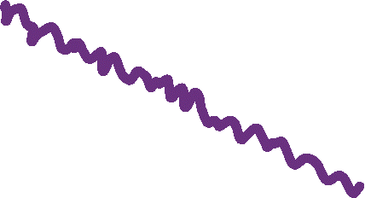


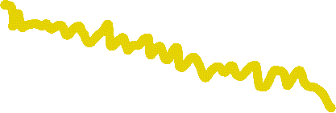


Integrating local and pairwise neural time-series dynamics to classify schizophrenia
CNS2022
Presented by:
Annie G. Bryant
Dynamics and Neural Systems Lab
The University of Sydney
Notes:
Hi everyone! My name is Annie, and I’m a PhD student in Ben’s group at the University of Sydney. For my workshop talk, I’ll be sharing my work examining how we can leverage univariate and pairwise time-series analysis to better understand differences in neural activity in neurological disorders, with this case study focusing on schizophrenia.

Slide 2
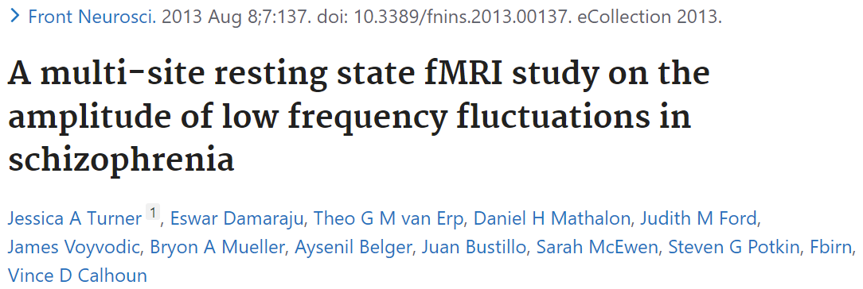
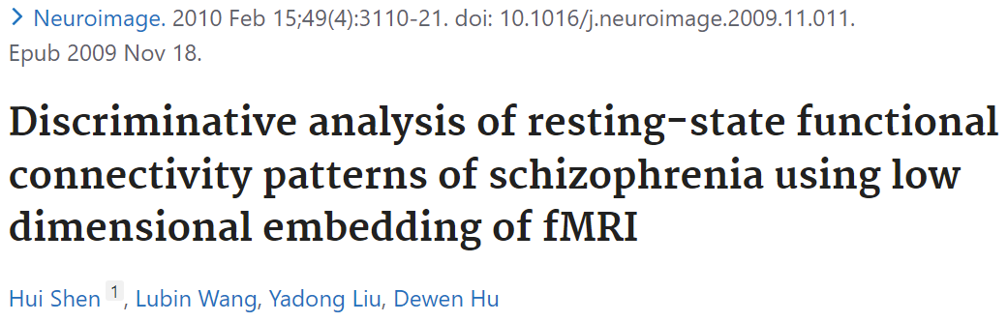
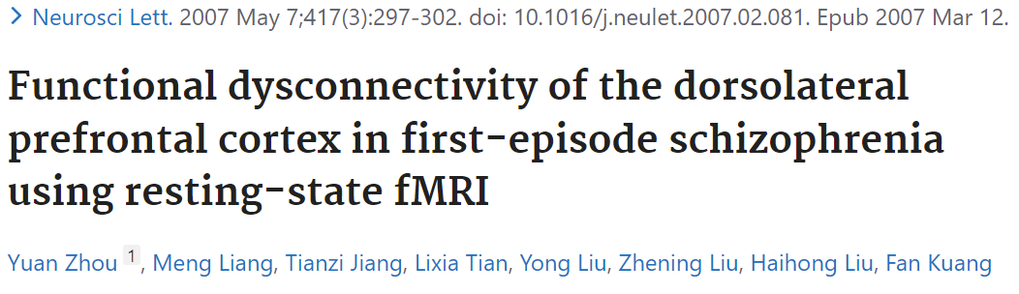
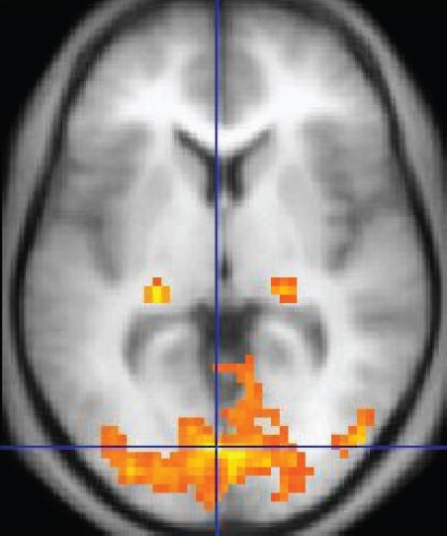
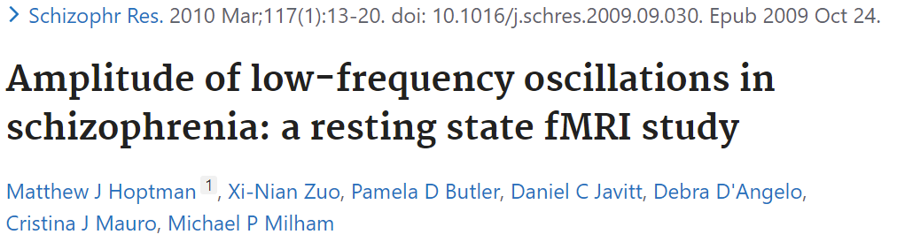
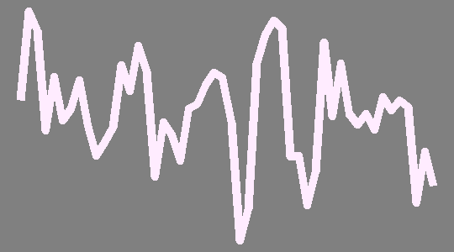

Functional neuroimaging as a tool to understand schizophrenia
BACKGROUND
METHODS
RESULTS
CONCLUSIONS
Schizophrenia: Psychiatric disorder that generally presents with delusions, disorganized thinking, hallucinations, and paranoia
Cognitive function deficits linked to altered neural activity in task-based functional neuroimaging¹
Functional magnetic resonance imaging (fMRI) blood oxygen level-dependent signaling (BOLD)
BOLD signal in one voxel
Based on ratio of oxygenated to deoxygenated hemoglobin in the blood
Serves as proxy readout for neuronal activity
¹Karlsgodt, Sun, and Cannon. Curr Dir Psychol Sci (2010)
Notes:
Schizophrenia is a psychiatric disorder that includes hallmark symptoms like delusions, disorganized thinking, hallucinations, and paranoia. These cognitive deficits are associated with altered neural activity in task-based functional neuroimaging.
[click] These alterations in neural activity can be detected using fMRI, which measures the amount of blood flowing through a voxel over time as a proxy for neural activity.
[click] Because schizophrenia is characterized by dysfunction across networks in the brain, it’s a prime candidate for neuroimaging-based classification studies. I’ve highlighted here just a few key studies from the last ten or so years that use resting-state fMRI to classify individuals with versus without schizophrenia.

Slide 3
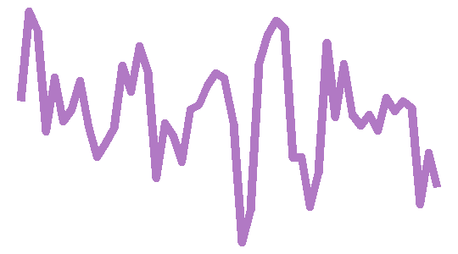
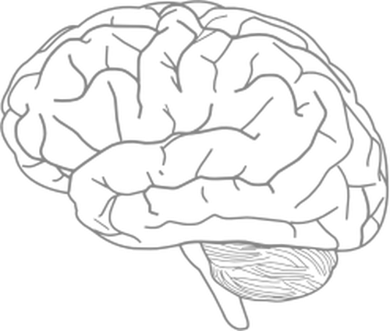
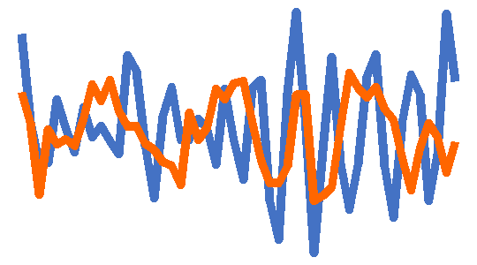
BOLD-measured neural activity represents an interacting system with individual components
BACKGROUND
METHODS
RESULTS
CONCLUSIONS
Pairwise functional connectivity dynamics
Higher-order interaction networks
Local regional dynamics
Example: fALFF
Example: Pearson correlation coefficient
Example: Node degree within graph network
Notes:
To zoom out a bit from schizophrenia, fMRI-measured neural activity in general can be thought of as an interacting system comprised of individual components. At the local level, we have activity dynamics in an individual brain region, like the middle frontal cortex. From an individual region, we can derive univariate features of activity time-series, for example the fractional amplitude of low-frequency fluctuations.
[click] At the next level up, we can consider the dynamics between pairs of brain regions using pairwise statistics, like the Pearson correlation coefficient. If you calculate such a statistic for all pairs of brain regions, you can construct a functional connectivity map.
[click] At the highest level, we can consider higher-order interaction networks based on the relationship between three or more brain regions. At this level, you might examine measurements like a brain region’s degree within the graph network.

Slide 4
Current State of the Neuroimaging Subject Classification Union
BACKGROUND
METHODS
RESULTS
CONCLUSIONS
Pairwise functional connectivity dynamics
Local regional dynamics
OR
Only 1-2 features are selected a priori based on literature standards
Complex classification models may obscure the actual brain region and time-series feature contributions to classification
Example: fALFF
Example: Pearson correlation coefficient
Notes:
For today’s workshop, I’ll be focusing on the first two levels: namely, regional univariate time-series dynamics and pairwise bivariate time-series dynamics.
[click] In general, most studies that use neuroimaging to classify control versus disease populations generally employ local OR pairwise dynamics without combining the two;
[click] Studies generally select 1-2 time-series features a priori based on literature standards, like the fALFF for univariate dynamics and the Pearson correlation coefficient for pairwise dynamics; and
[click] Complex classification models tend to yield high classification accuracy but at the expense of obscuring the actual brain region and time-series features that are actually driving the classification. Understanding the anatomical and dynamical properties that distinguish schizophrenia from non-schizophrenia individuals would be highly clinically relevant.

Slide 5
Introducing an integrated approach for the comprehensive evaluation of local and pairwise neural dynamics
BACKGROUND
METHODS
RESULTS
CONCLUSIONS
Pairwise functional connectivity dynamics
Local regional dynamics
AND
Dozens to hundreds of features derived from interdisciplinary research are evaluated
Goal: combine univariate and multivariate time-series features in a biologically interpretable classification model
Example: fALFF
Example: Pearson correlation coefficient
Notes:
[click] To address this, we are taking a new approach to neural time-series data analysis that integrates univariate and pairwise statistics to better understand neural activity dysfunction in individual brain regions as well as brain networks.
[click] With this pipeline, we can automatically extract dozens to hundreds of time-series features from fMRI data that are founded in interdisciplinary research areas from physiology to econometrics to [one more area from hctsa].
[click] Our goal is to comprehensively study univariate and pairwise time-series features that yield biologically interpretable insights from classification analysis.

Slide 6

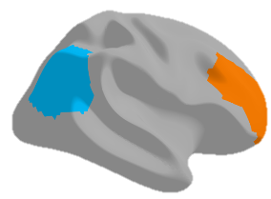
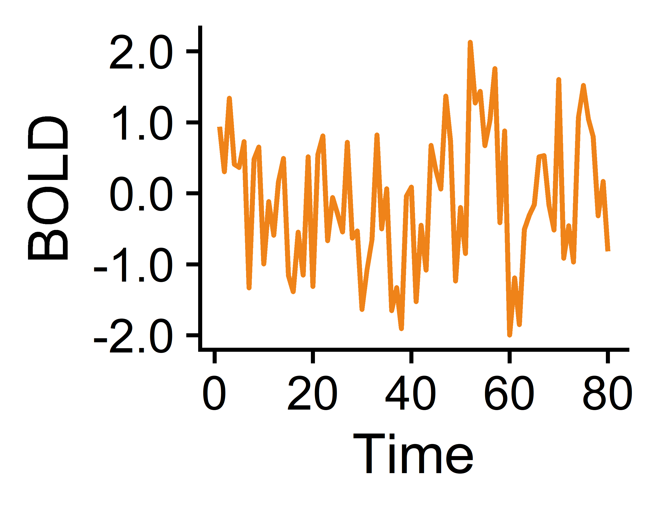
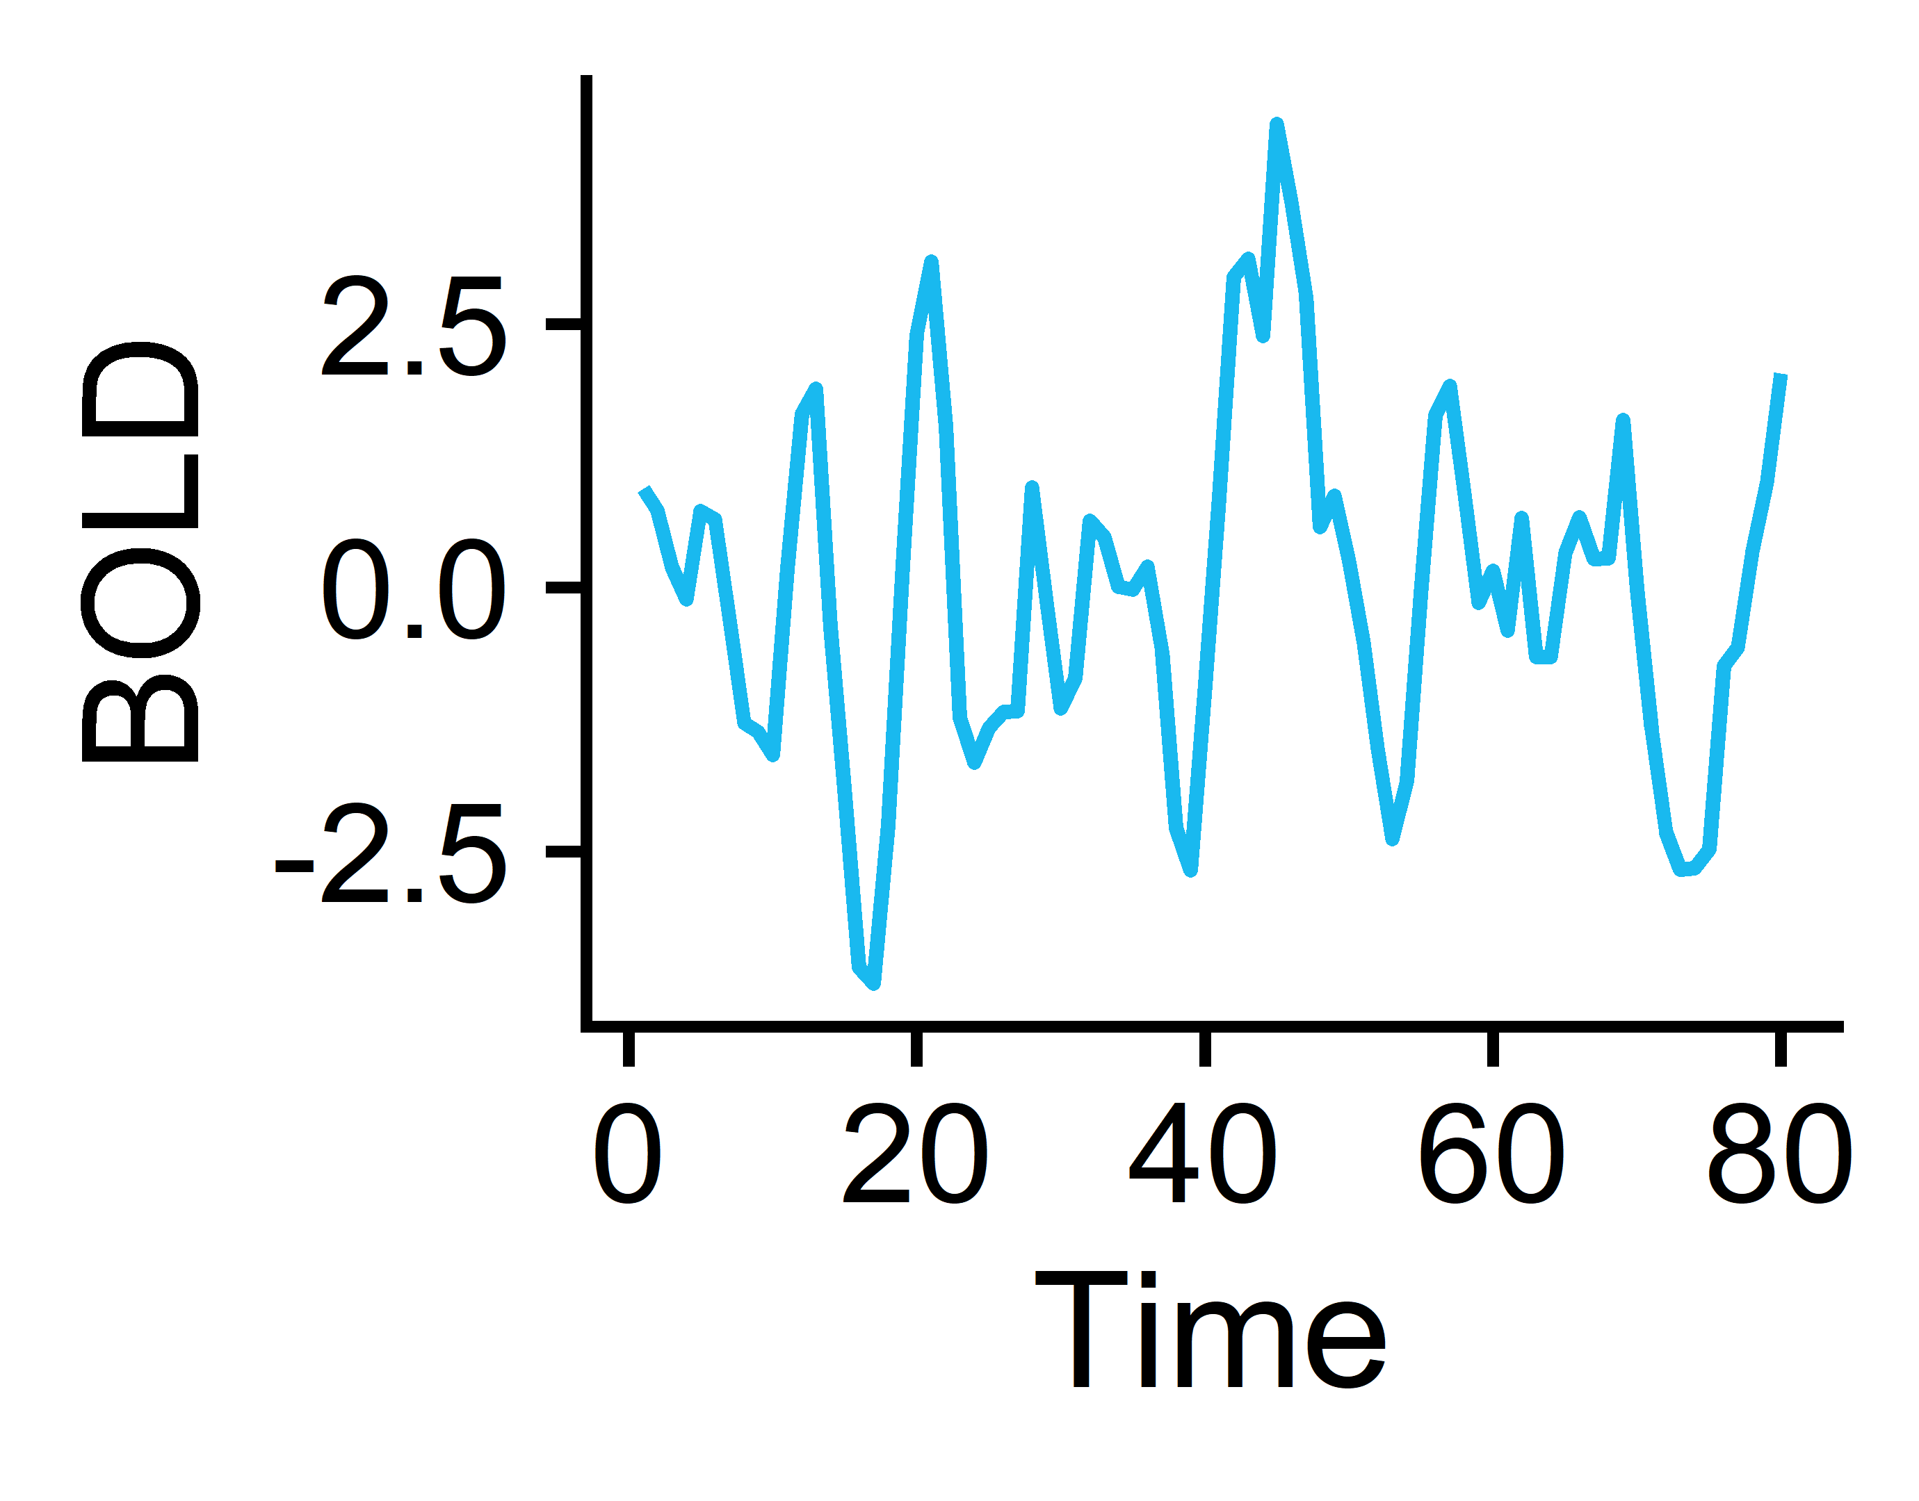
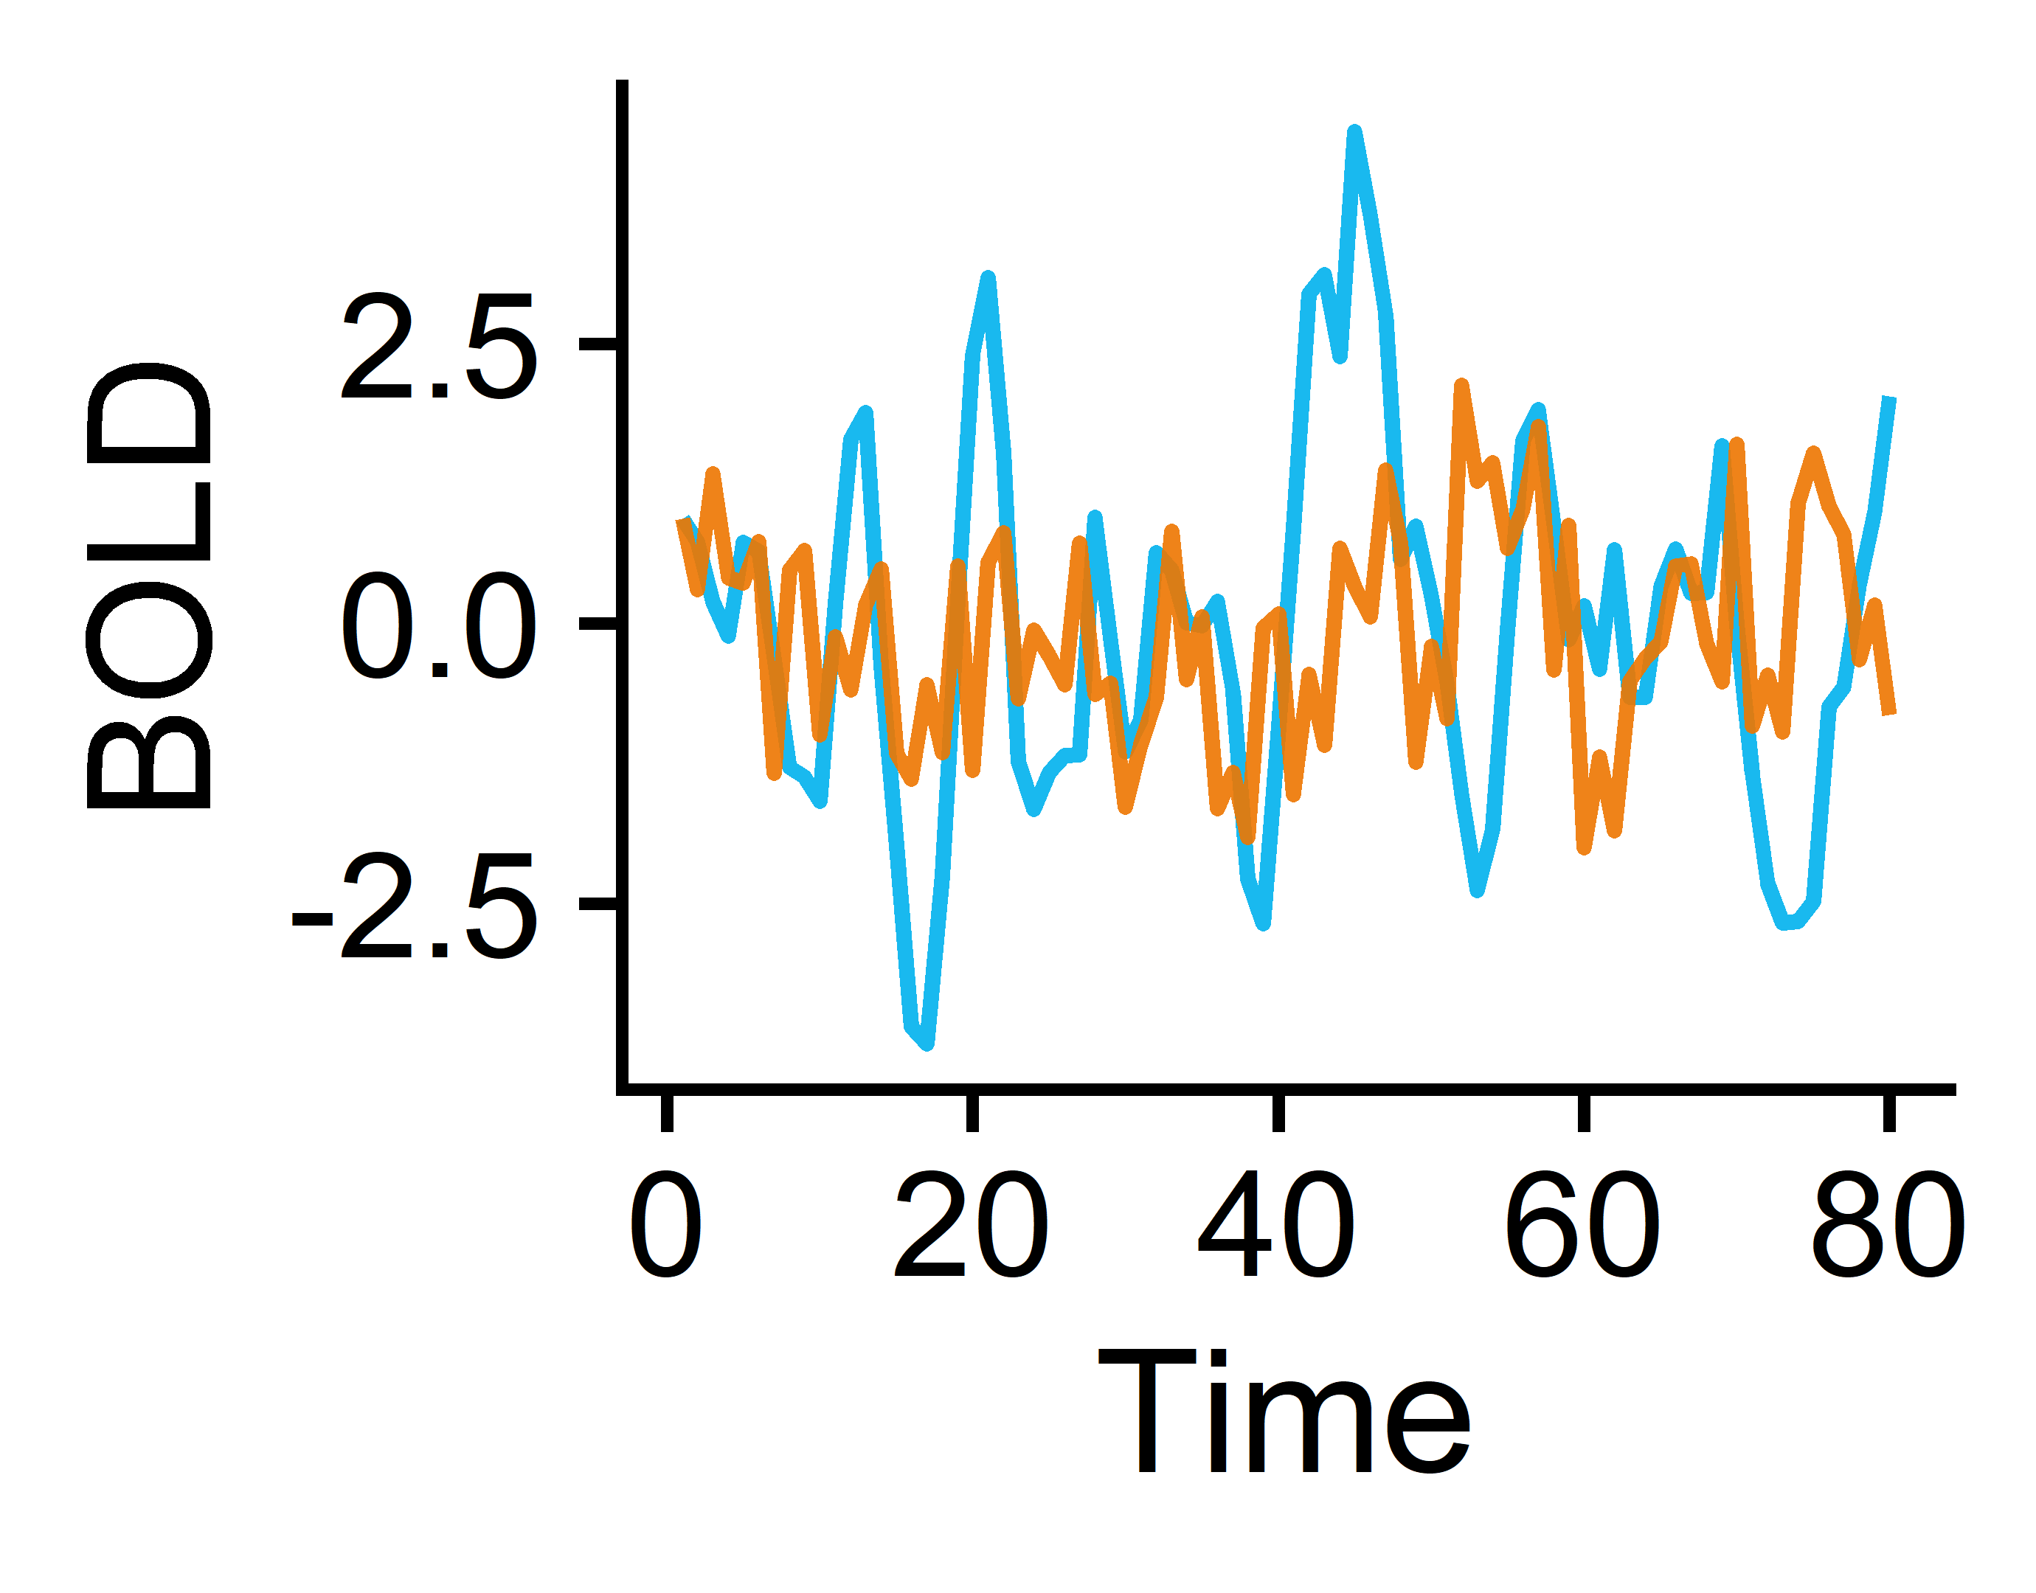
From BOLD fMRI to time-series (TS) feature matrices: a 🐤’s-👁 view
BACKGROUND
METHODS
RESULTS
CONCLUSIONS
Brain
Regions 1-82
Measure BOLD temporal signals in 41 cortical + subcortical regions per hemisphere
Extract univariate TS features from each brain region
Subjects¹
Subjects (165)
N=118 Controls
Univariate features (22)
fMRI processing:
fmriPrep
ICA-based Automatic Removal of Motion Artifacts (AROMA)
Regress out artifacts from AROMA, signal from white matter + CSF, and signal from global gray matter (AROMA+2P+GMR)
Freesurfer (structural MRI)
Region pairs 1-6,632
Subjects (165)
N=47 with Schizophrenia
Extract pairwise TS features from each brain region pair
Pairwise features (18)
¹Gorgolewski KJ et al. A Preprocessed consortium for Neuropsychiatric Phenomics dataset. (2017).
Notes:
To give a bird’s-eye view of our approach, we chose to work with an open-access dataset from the UCLA Consortium for Neuropsychiatric Phenomics that contains 118 control participants and 47 participants with schizophrenia.
[click] For each subject, we derived resting-state fMRI time-series from 41 cortical and subcortical regions per hemisphere. The fMRI preprocessing included fMRIprep along with independent component analysis-based removal of motion artifacts as well as signal from white matter and CSF, with global gray matter regression. To define our regions of interest, we used the Desikan-Killiany atlas from Freesurfer’s cortical parcellation and subcortical segmentation.
[click] For each of these brain regions, we extracted univariate time-series features which I’ll touch on more in the next slide,
[click] which distilled our four-dimensional time-series data into a series of two-dimensional matrices, containing the subject by feature values for each brain region.
[click] We also examined pairwise time-series features that characterize interactions between pairs of brain regions,
[click] which also yields a set of subject-by-feature matrices, this time for the 6,632 pairs of brain regions contained in this atlas.

Slide 7
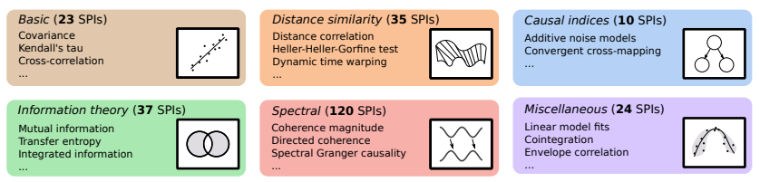


Curating time-series feature sets
BACKGROUND
METHODS
RESULTS
CONCLUSIONS
Pairwise features (statistical pairwise interactions; SPIs)
Univariate features
theft¹
catch22
tsfel
feasts
pyspi³
>1,300 features
249 SPIs
tsfresh
tsfeatures
kats
22 features derived in a data-driven manner² spanning time-series properties including linear and nonlinear autocorrelation, periodicities, consecutive stretches, and simple forecasting
18 SPIs that include dynamic time warping, spectral Granger causality, transfer entropy, and additive noise modeling
¹Henderson T and Fulcher BD. ICDMW (2021).
²Lubba CH et al. Data Min Knowl Discov (2019).
³Cliff OM et al. arXiv (2022).
Notes:
I’ll just provide some context for the time-series properties we extracted from the fMRI data. For the univariate time-series features, we used the theft package in R developed by Trent Henderson in our group, which can automatically extract up to 1,300 time-series features from an input dataset.
[click] Given that we only have 165 subjects, we wanted to work with a minimally redundant and maximally informative subset of these features to reduce the feature dimensionality. Previous work from our collaborator Carl Lubba at Imperial College London identified a subset of 22 features in a data-driven manner that effectively represent the broader feature space, capturing properties from linear and nonlinear autocorrelations to periodicities to consecutive stretches to simple forecasting.
[click] In terms of the pairwise time-series features that capture relationships between brain regions, we used pySPI, which is a python-based toolkit that Oliver Cliff from our group developed. This is a comprehensive library of 249 different pairwise time-series statistics that span six overarching types of dynamics, including basic statistics, distance similarity, causal indices, information theory, and spectral properties.
[click] As with the univariate time-series features, we took a principled approach to subset the full suite of SPIs down to 18 such that all six SPI categories are represented by at least one SPI.

Slide 8
Results, part one: univariate statistics
BACKGROUND
METHODS
RESULTS
CONCLUSIONS
Local regional dynamics
Notes:
So first, I’ll walk us through our findings using the univariate time-series statistics that pertain to neural activity in individual brain regions.

Slide 9
Classification method overview
BACKGROUND
METHODS
RESULTS
CONCLUSIONS
1. Region-wise classification
2. Feature-wise classification
3. Combo-wise classification
Brain
Regions 1-82
Univariate TS features 1-22
…
TS Feature 1
TS Feature 22
Region 1
Region 82
Region 1
Region 82
Subjects (165)
Subjects (165)
…
…
Subjects (165)
Univariate features (22)
Brain regions (82)
Linear SVM by Brain Region
Linear SVM by Univariate TS feature
Linear SVM with all Region-by-Feature combinations (n=1,804)
Region 1
Region 2
Region 82
Feature 1
Feature 2
Feature 22
…
…
Goal: Identify which region(s) exhibit significantly different overall neural activity in participants with vs. without schizophrenia
Goal: Identify which univariate TS feature(s) exhibit globally altered properties in participants with vs. without schizophrenia
Goal: Identify which region(s) exhibit specifically altered individual activity dynamics in participants with vs. without schizophrenia
Notes:
We chose to break the univariate region-based analysis down into three distinct methods, the first being linear support vector machine or SVM classification based on individual brain regions. Here, we partitioned the data to yield a subject-by-feature matrix for each of our 82 brain regions and ran 82 corresponding linear SVMs, with the goal being to identify if there are one or more regions that exhibit overall altered temporal dynamics that meaningfully separate schizophrenia from control participants;
[click] The second method was to flip the script and partition the data to yield a subject-by-brain-region matrix for each of our 22 features and run 22 corresponding SVMs, with the goal now being to identify if there are any time-series properties that are globally altered in the schizophrenia brain relative to controls;
[click] And our third approach was to combine each pair of regions and time-series features in one SVM model that incorporated all of the available information.
OR AS I LIKE TO THINK OF IT….

Slide 10

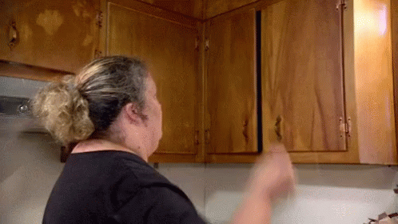
Classification method overview
BACKGROUND
METHODS
RESULTS
CONCLUSIONS
1. Region-wise classification
2. Feature-wise classification
3. Combo-wise classification
Brain
Regions 1-82
Univariate TS features 1-22
…
TS Feature 1
TS Feature 22
Region 1
Region 82
Region 1
Region 82
Subjects (165)
Subjects (165)
…
…
Subjects (165)
Univariate features (22)
Brain regions (82)
Linear SVM by Brain Region
Linear SVM by Univariate TS feature
Linear SVM with all Region-by-Feature combinations (n=1,804)
Region 1
Region 2
Region 82
Feature 1
Feature 2
Feature 22
…
…
Goal: Identify which region(s) exhibit significantly different overall neural activity in participants with vs. without schizophrenia
Goal: Identify which univariate TS feature(s) exhibit globally altered properties in participants with vs. without schizophrenia
Goal: Identify which region(s) exhibit specifically altered individual activity dynamics in participants with vs. without schizophrenia
Note: to account for class imbalances, samples were weighted according to the inverse proportion of their class membership (Schizophrenia vs. Control) and balanced accuracy was used as the performance metric.
Notes:
…throwing all the univariate time-series spaghetti at the wall and seeing what sticks.
[click] I will also point out that we applied inverse probability weighting to all samples based on the inverse proportion of their class membership (i.e. schizophrenia or control) and measured classification performance with balanced accuracy to reflect the class imbalance between schizophrenia and control participants.
If anyone asks: balanced accuracy is technically defined as the mean between sensitivity and specificity, which are the true positive rate and true negative weight, respectively. In other words, it applies equal weighting to the classification rates of both classes.

Slide 11

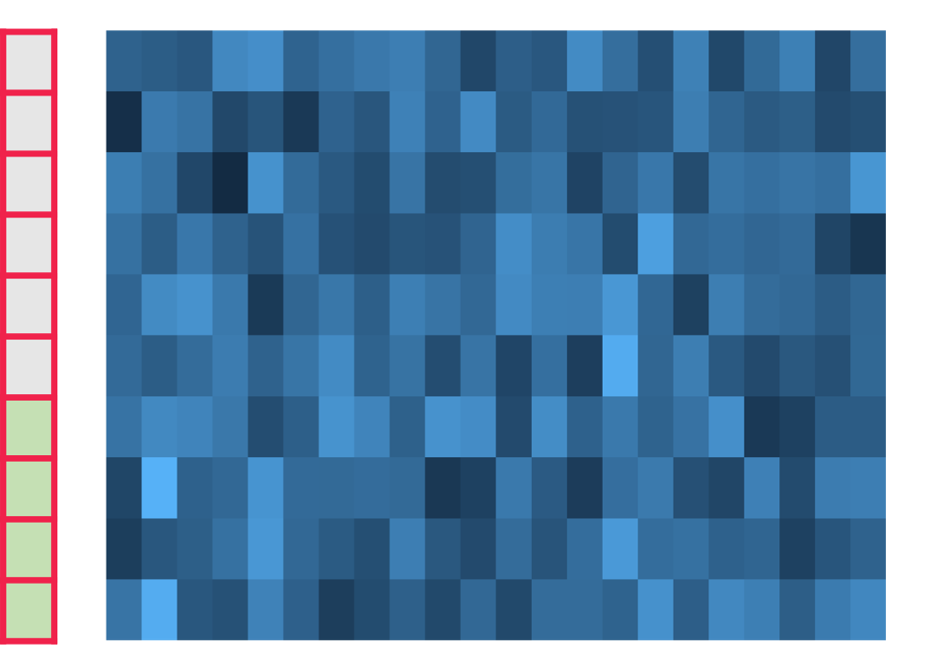
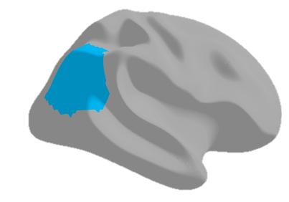
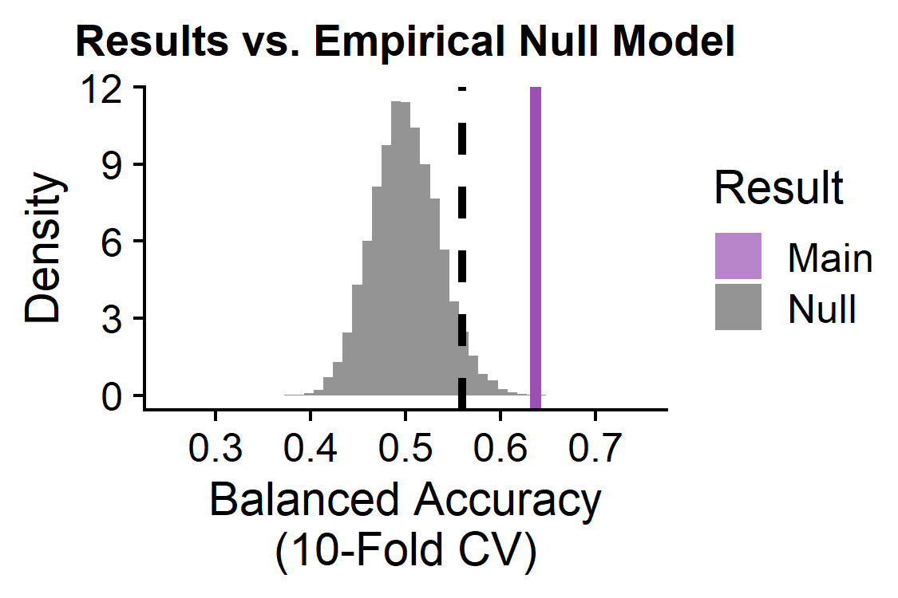
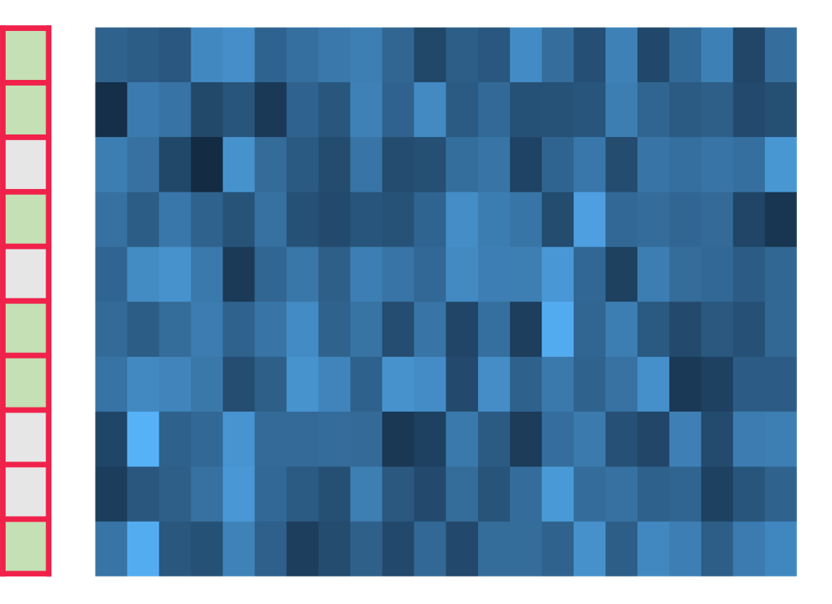
Evaluating statistical significance : pooled empirical null modeling
BACKGROUND
METHODS
RESULTS
CONCLUSIONS
Linear SVM
Observed classification balanced accuracy
Group labels
Subjects (165)
Extract TS features
10-fold CV
Example region: right inferior parietal cortex
catch22 features
Shuffle group labels
Repeat 1,000X per brain region
Null permutation classification balanced accuracy
Group labels
Subjects (165)
Linear SVM
10-fold CV
p-value = # null iterations with balanced accuracy greater than the actual result
catch22 features
Notes:
Some of you may already be well versed in null model-based permutation testing, but I’ll just summarise our implementation so we’re all on the same page. For example, let’s say we’re looking at the time-series properties from the right inferior parietal cortex;
[click] We extract our subject-by-feature matrix in which each row is a subject with a corresponding label of either control or schizophrenia;
[click] We run a 10-fold cross-validated linear SVM and calculate our balanced accuracy. In order to understand how significant this is relative to chance performance with our input features, we compare this metric against a pooled null distribution.
[click] To do this, we keep our feature matrix the exact same, but randomly shuffle our group labels that we input to the SVM.
[click] We then run the same cross-validated linear SVM, which gives us one null model balanced accuracy value.
[click] We repeated this for 1,000 iterations per brain region, and then aggregate all of the null iterations across all of the brain regions to yield 82,000 null values. This pooled technique is a valid way to increase your null distribution size and minimize computation time if the null distribution for each region is normally distributed around the same mean, which in this case is 50% balanced accuracy.
[click] For each brain region, the observed real balanced accuracy is assigned a p-value corresponding to the number of null iterations out of 82,000 that yielded higher balanced accuracy. In cases where we’re comparing many brain regions or many features, we apply Benjamini-Hochberg adjustment for multiple comparisons.

Slide 12
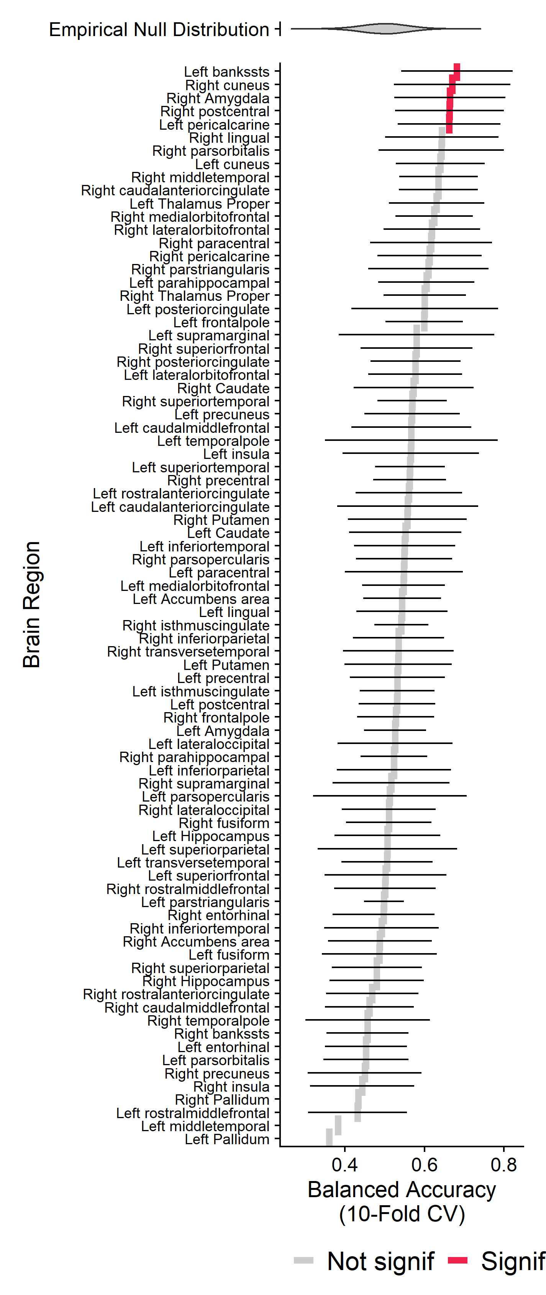
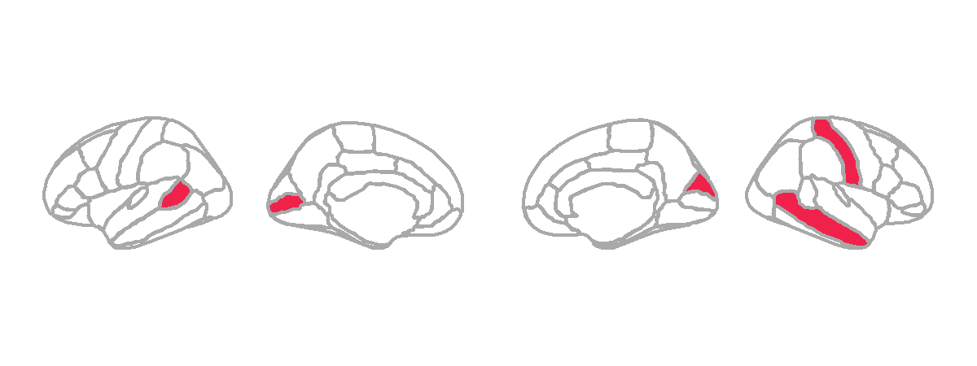
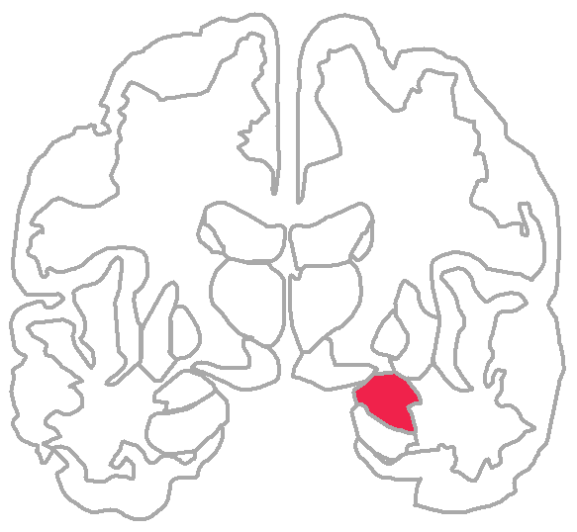
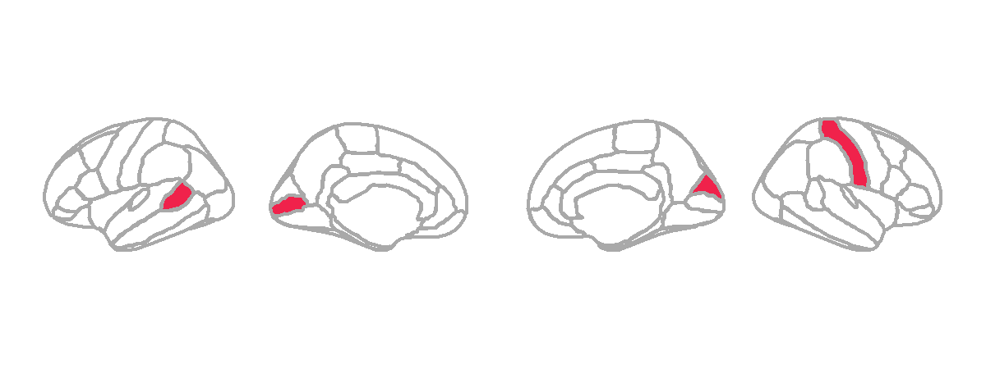
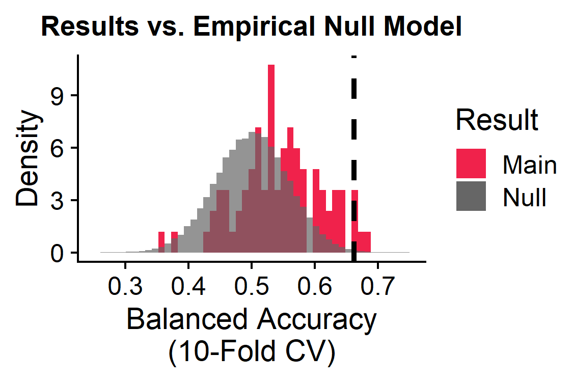
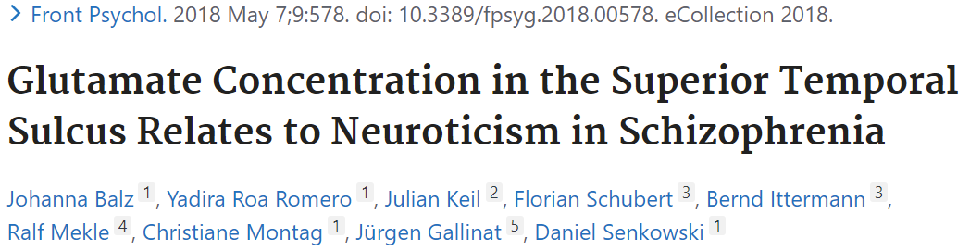
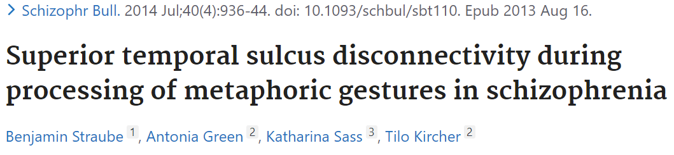
Five brain regions show altered temporal dynamics in schizophrenia
BACKGROUND
METHODS
RESULTS
CONCLUSIONS
Left
Brain
Regions 1-82
L
R
L
2
1
4
Subjects (165)
3
5
Univariate features (22)
Right
5/82 brain regions significant:
L banks of the superior temporal sulcus
L pericalcarine
R cuneus
R postcentral
R amygdala
BH-adjusted p<0.05
Notes:
So when we look at the data from a region-based perspective, we actually found five brain regions that gave statistically significant balanced accuracies:
[click] the left banks of the superior temporal sulcus, left pericalcarine cortex, right cuneus, right postcentral, and right amygdala.
[click] While we haven’t had the chance to really dig into this anatomy yet, I did have a quick google scholar search on the first region (left banks of the superior temporal sulcus) and found a couple of papers suggesting that this region may have glutamate imbalances that give rise to aberrant activity in schizophrenia, as well as dysconnectivity from other parts of the temporal cortex.
It’s also worth pointing out that the pericalcarine cortex and cuneus are visual regions and the postcentral gyrus is the primary somatosensory cortex, implicating the sensorimotor network in the region-based altered activity. When I presented these findings with my poster, one person suggested this may be related to visual hallucinations that can present in schizophrenia, which I thought was a really interesting possibility to follow up on.

Slide 13
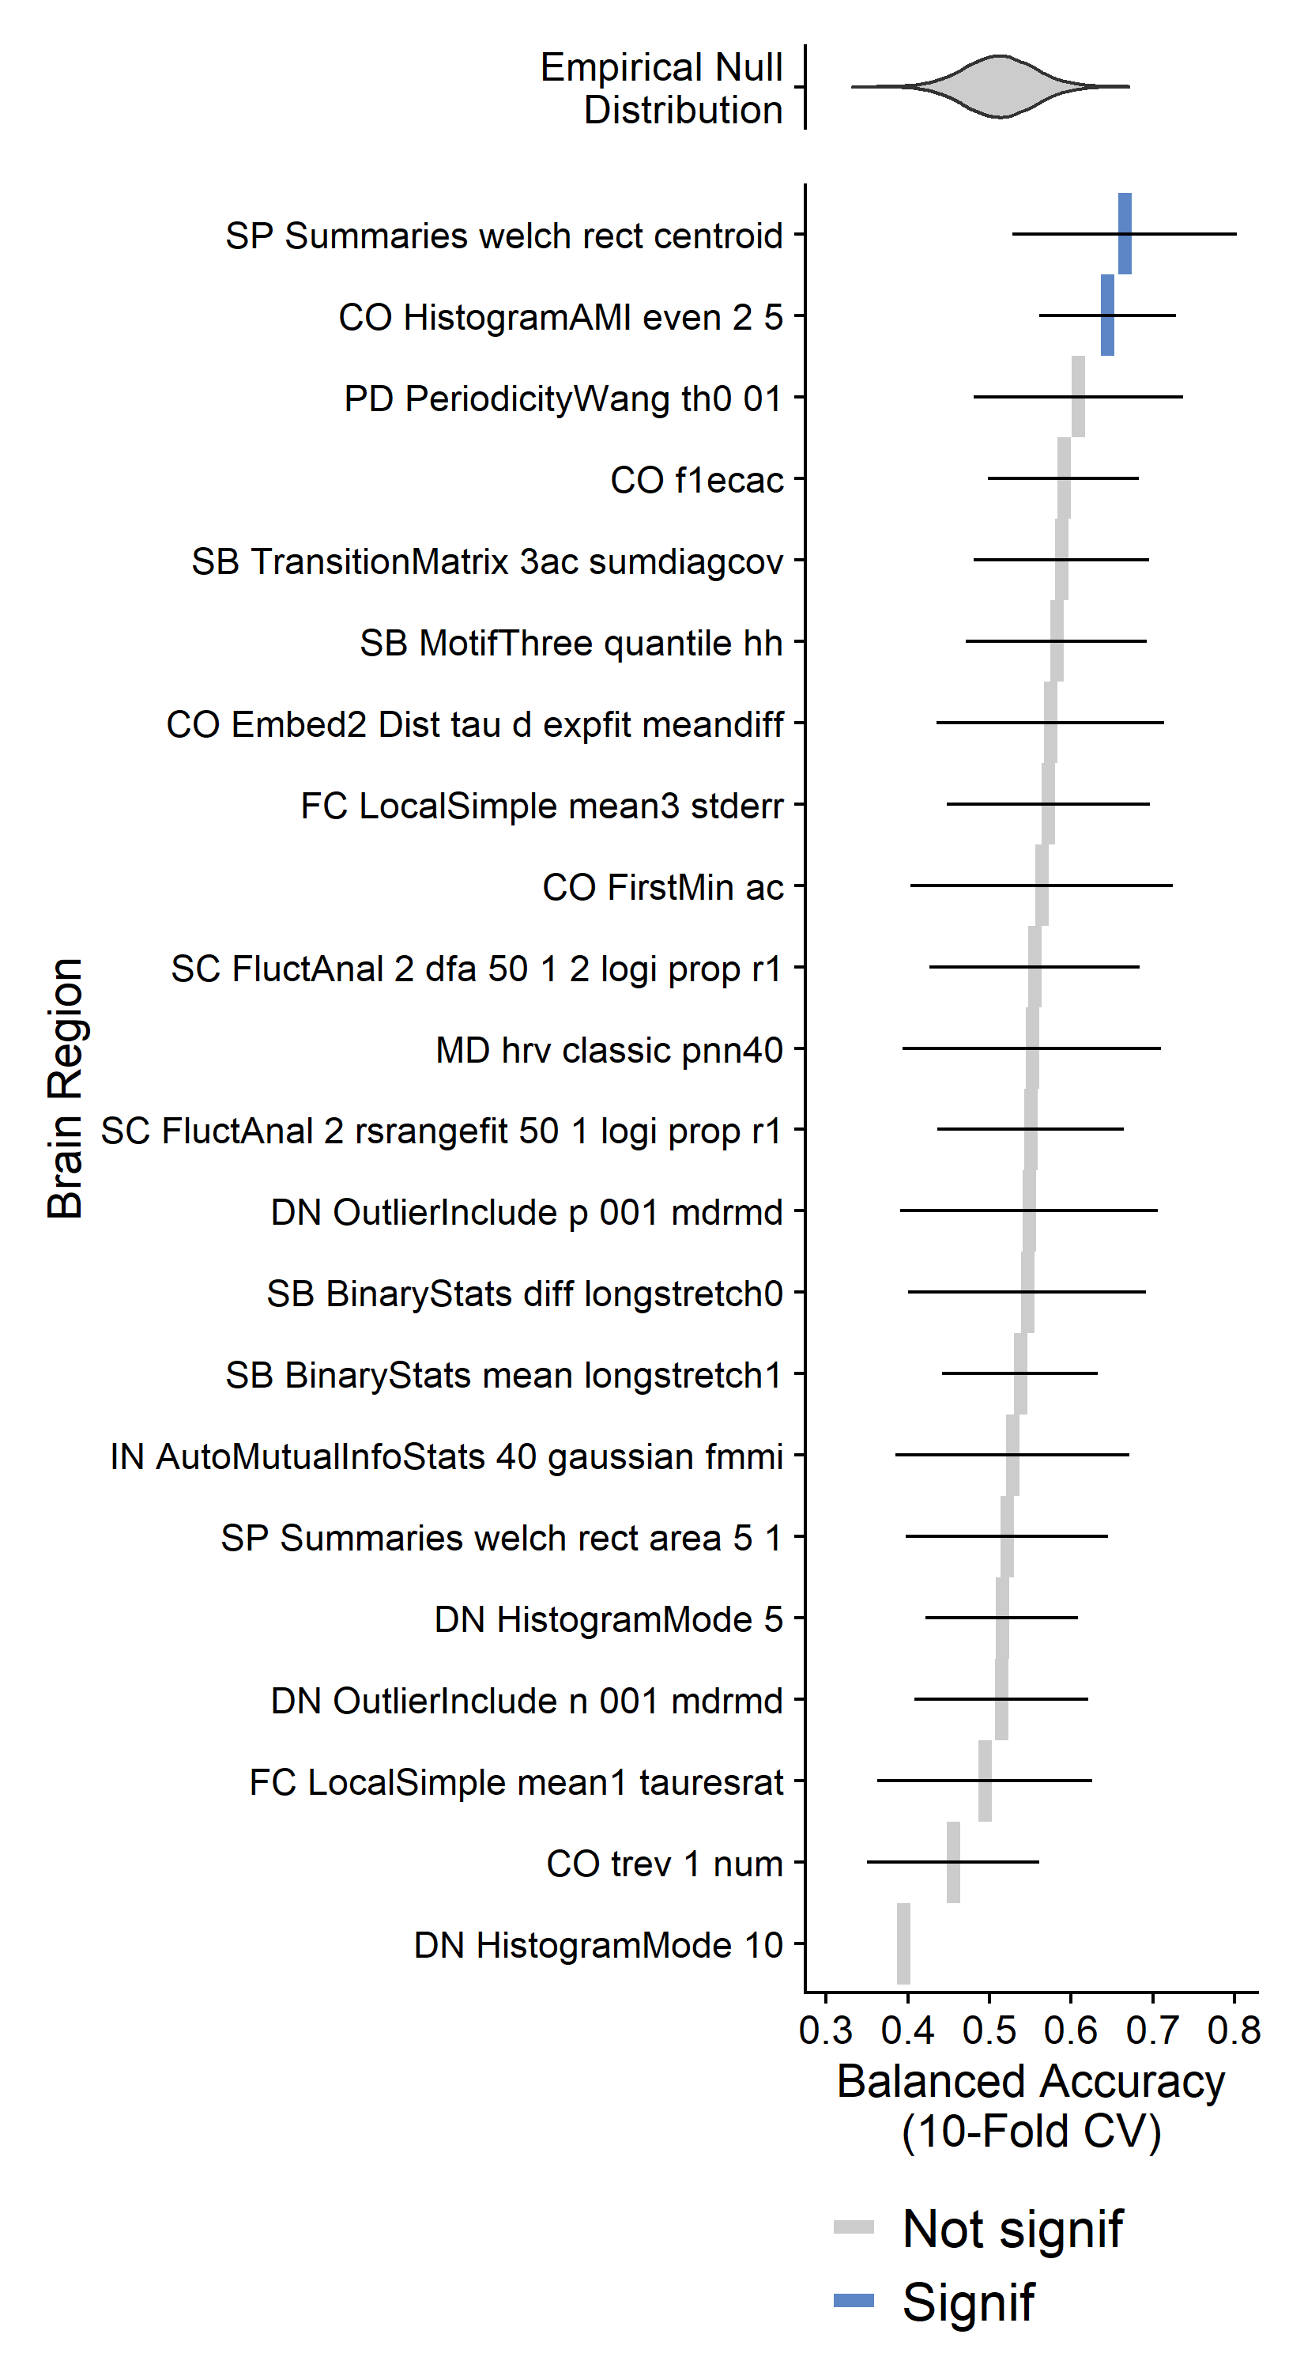
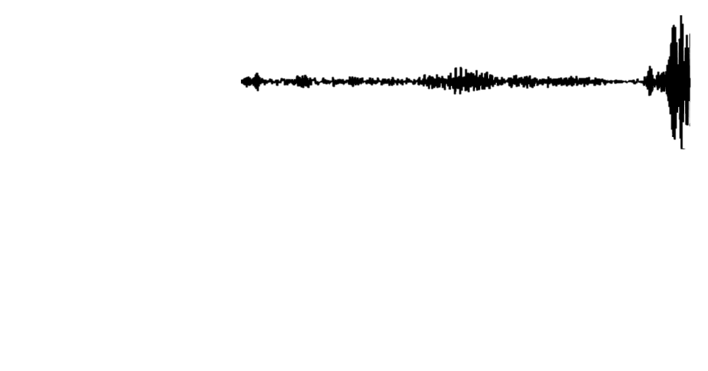
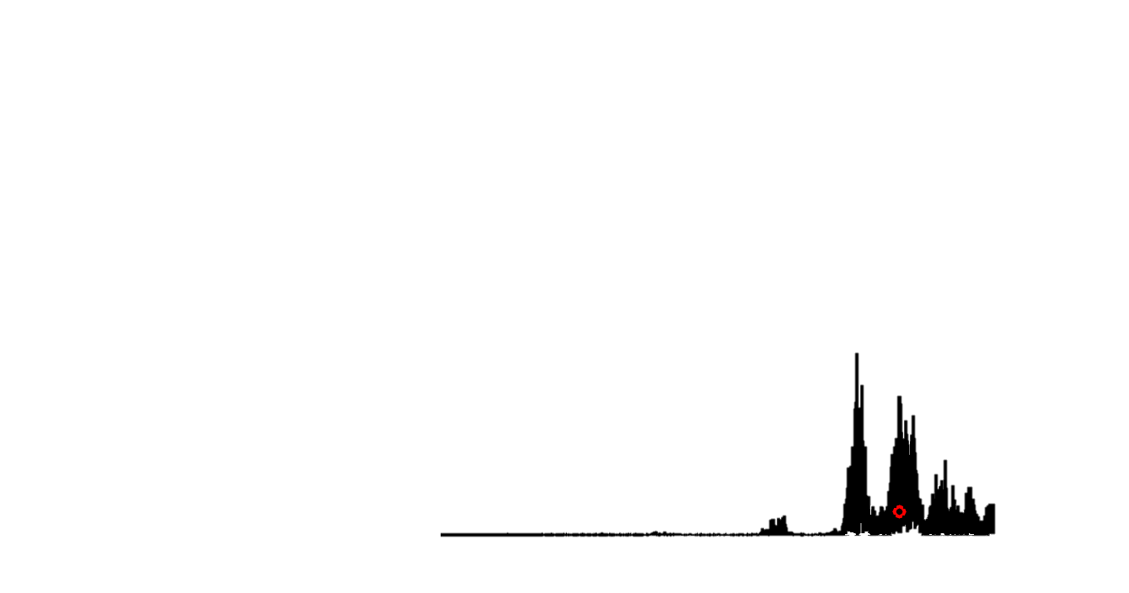
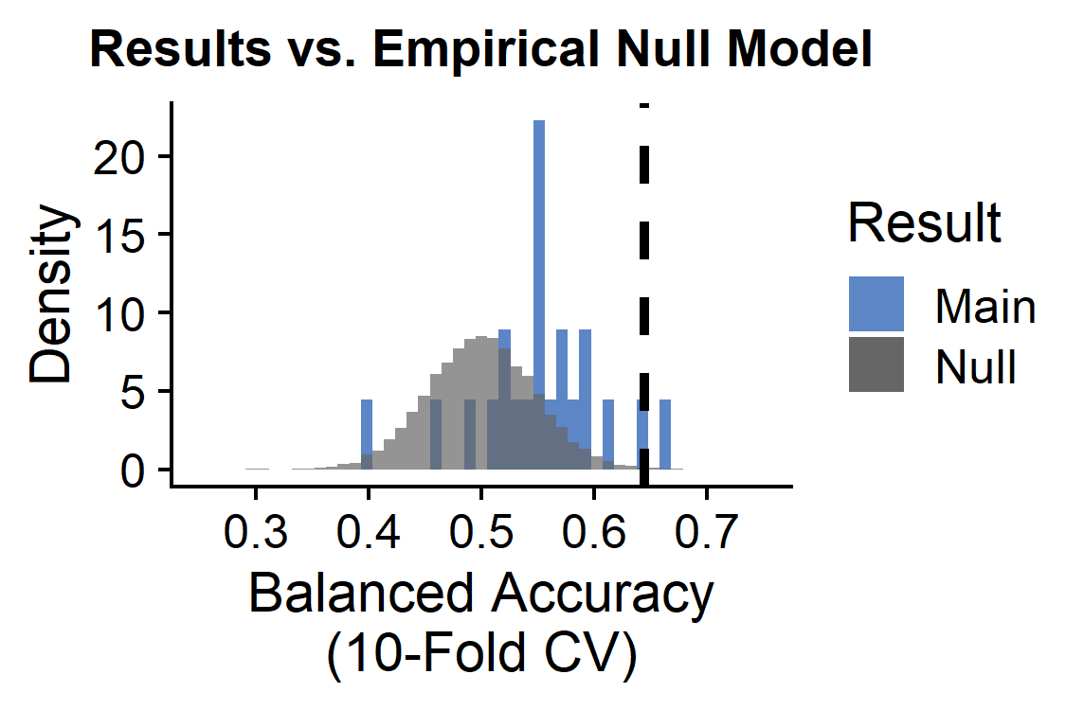
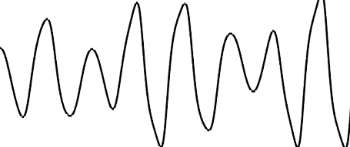
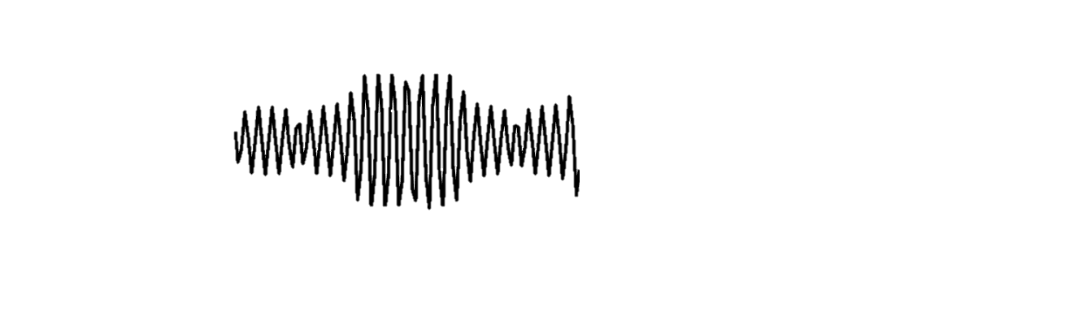
Two TS features show globally altered properties in schizophrenia
BACKGROUND
METHODS
RESULTS
CONCLUSIONS
2/22 univariate TS features significant:
Univariate TS features 1-22
SP_Summaries_welch_rect_centroid: Centroid of the Welch-estimated power spectral density (PSD)
Subjects (165)
Value
Time
Brain regions (82)
PSD
Frequency
CO_HistogramAMI_even_2_5: Nonlinear autocorrelation function with bins of 5 at lag τ = 2
BH-adjusted p<0.05

Slide 14
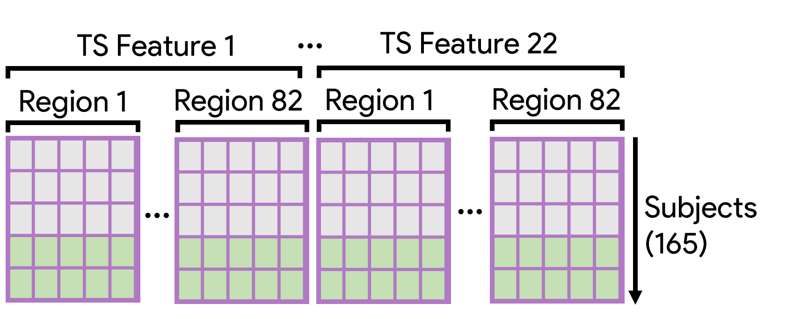
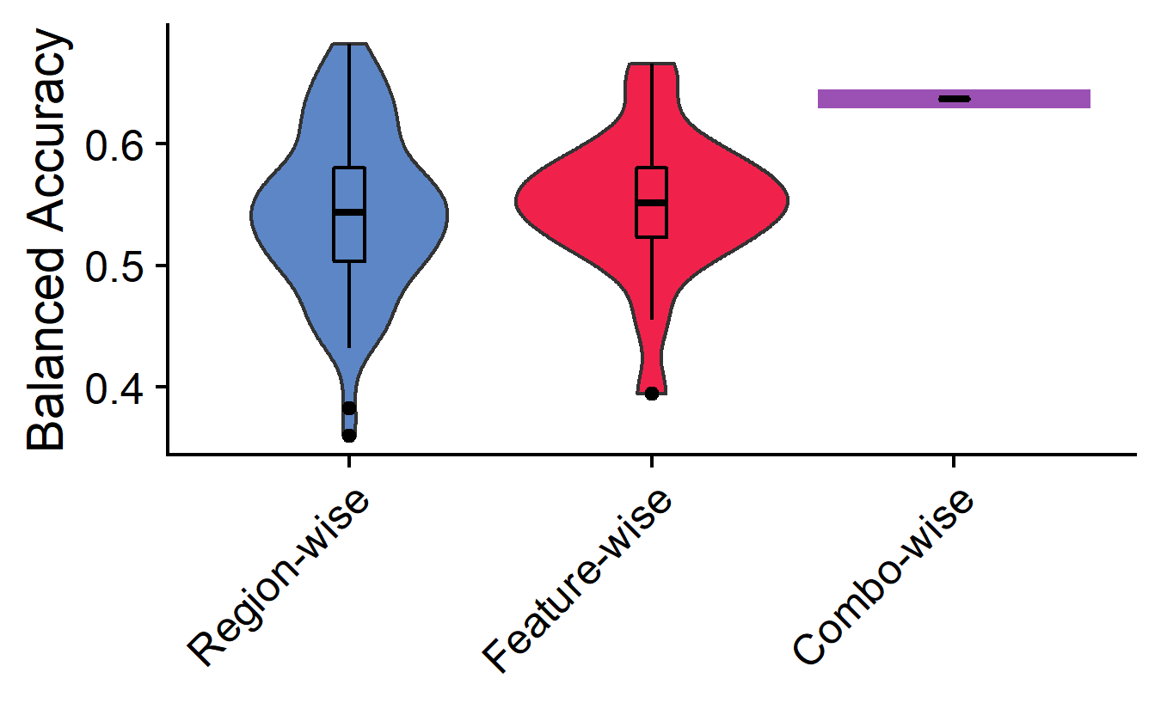
The combination of brain region X time-series dynamics
BACKGROUND
METHODS
RESULTS
CONCLUSIONS
Balanced accuracy = 64%
(p ≈ 1 × 10⁻⁵)
Combo-wise linear SVM yields balanced accuracy higher than 90% (74/82) of individual brain regions and 90% (20/22) of individual univariate TS features

Slide 15
Results, the sequel: pairwise statistics
BACKGROUND
METHODS
RESULTS
CONCLUSIONS
Pairwise functional connectivity dynamics

Slide 16
Univariate + pairwise statistics coming together
BACKGROUND
METHODS
RESULTS
CONCLUSIONS
SPI-wise classification
Pairwise features + univariate features classification
SPIs 1-18
SPIs 1-18
+
Subjects (165)
Subjects (165)
Brain region pairs (6,632)
Brain region pairs (6,632)
Linear SVM by SPI
Linear SVM by SPI with all Region-by-Feature combinations (1,804)
SPI 1
SPI 2
SPI 18
SPI 1
SPI 2
SPI 18
…
…
Goal: Identify which set(s) of pairwise interactions exhibit significantly different brain-wide dynamics in participants with vs. without schizophrenia
Goal: Identify which set(s) of pairwise interactions exhibit improved classification performance with the addition of univariate region-by-TS-feature data
Note: to account for class imbalances, samples were weighted according to the inverse proportion of their class membership (Schizophrenia vs. Control) and balanced accuracy was used as the performance metric.

Slide 17
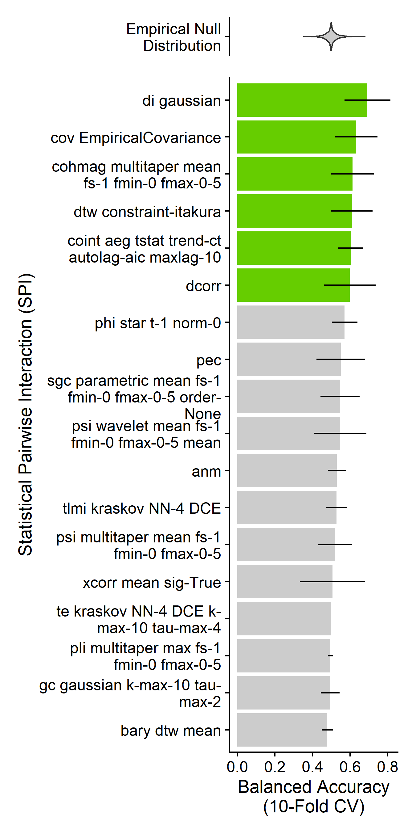
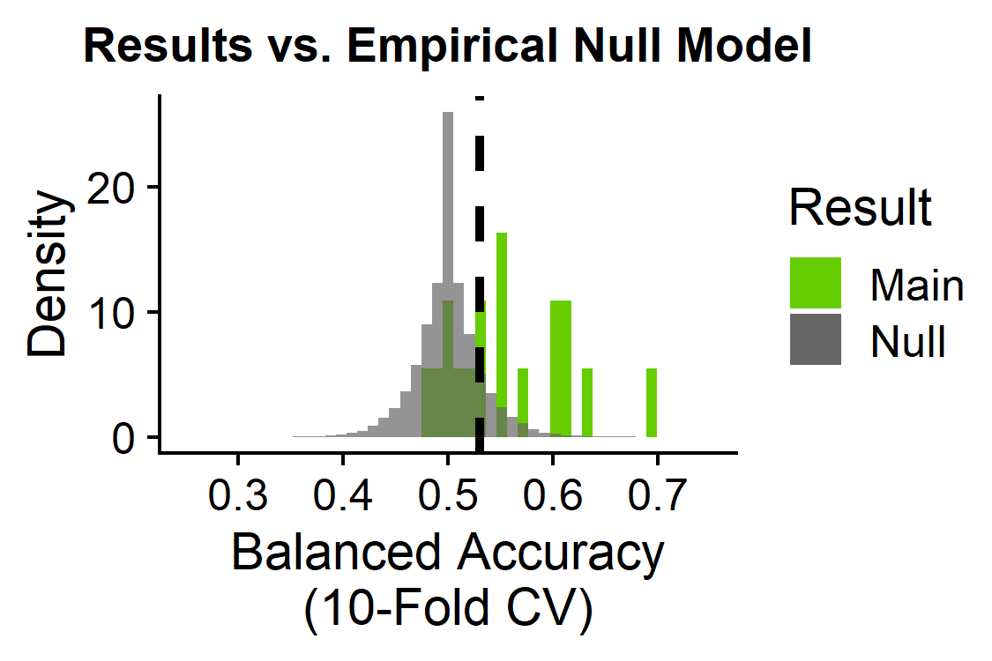
Six pairwise temporal dynamics are globally altered in schizophrenia
BACKGROUND
METHODS
RESULTS
CONCLUSIONS
6/18 statistical pairwise interactions significant:
SPIs 1-18
Basic statistics
cov_EmpiricalCovariance: Pearson correlation
Information theory
di_gaussian: Directed information with a Gaussian-distribution model
Spectral
cohmag_multitaper_mean_fs-1_fmin-0_fmax-0-5: Coherence magnitude for full frequency range
Distance similarity
dtw_constraint-itakura: Dynamic time warping with Itakura parallelogram constraints
dcorr: Euclidean distance correlation
Miscellaneous features
coint_aeg_tstat_trend-ct_autolag-aic_maxlag-10: cointegration with Augmented Engle-Granger two-step test with a constant and linear trend
Brain region pairs (6,632)
Subjects (165)
BH-adjusted p<0.05

Slide 18
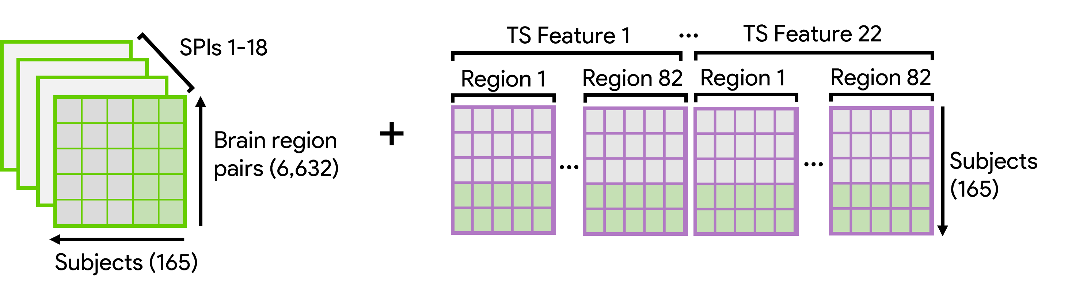
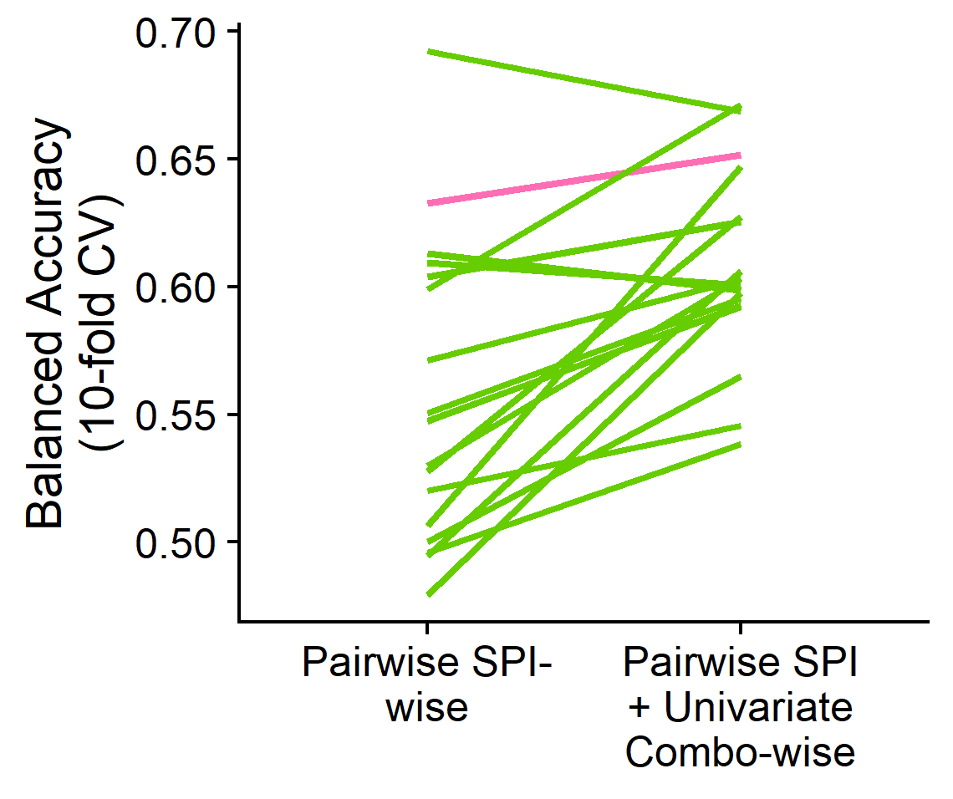
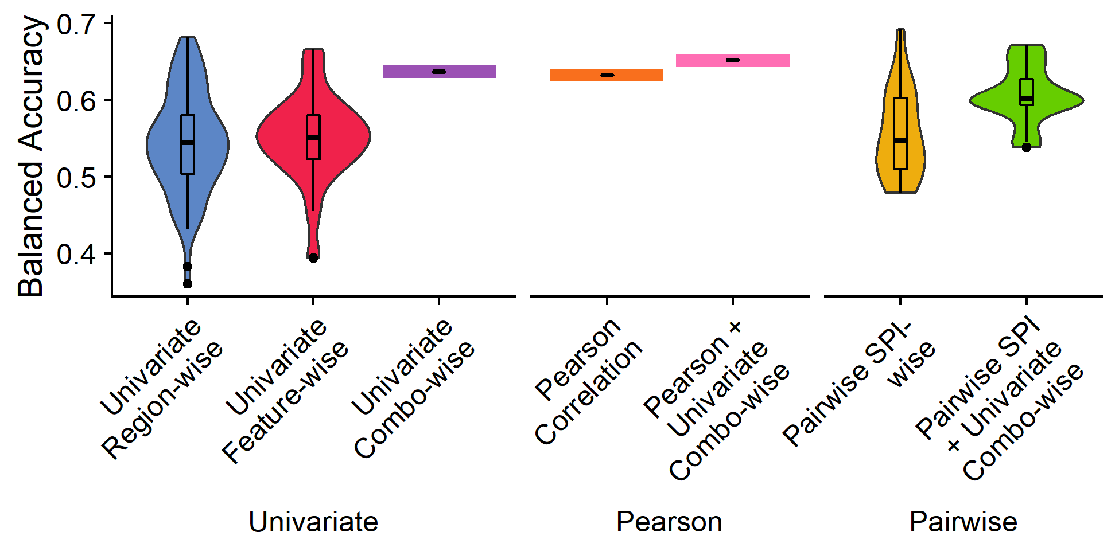
Pairwise FC features perform better with the addition of region-specific univariate TS feature info
BACKGROUND
METHODS
RESULTS
CONCLUSIONS
di_gaussian
dcorr
Pearson correlation coefficient
All other SPIs
Most pairwise SPIs (incl. Pearson correlation coefficient) show improved classification balanced accuracy with the inclusion of univariate region-by-TS-feature data (mean +5%)

Slide 19
Take-🏡 messages
BACKGROUND
METHODS
RESULTS
CONCLUSIONS
This workflow takes a comprehensive approach to characterizing local and pairwise neural activity dynamics in the brain
We can identify specific brain regions and time-series properties that distinguish between schizophrenia versus control participants with biological interpretability
The combination of all regions by time-series features together affords more information than most regions or features on their own
Incorporating regional univariate time-series info bolsters classification performance for most pairwise metrics

Slide 20
Limitations
BACKGROUND
METHODS
RESULTS
CONCLUSIONS
Next Steps
Potential for overfitting in high-dimensional inputs to classifier
Dimensionality reduction and feature selection algorithms
Comparing multiple pipelines for noise correction and evaluating effect of fractional displacement on classification performance
BOLD fMRI data can be noisy and confounded by motion
All work presented here is in one dataset (UCLA)
Apply generative model SVM to external dataset (e.g. COBRE)
Notes:
Limitations =
Next steps = dimensionality reduction to mitigate potential overfitting, feature selection to evaluate relative contribution of different regions x features, quality control, evaluate different feature subsets, apply classification model to a separate validation dataset

Slide 21
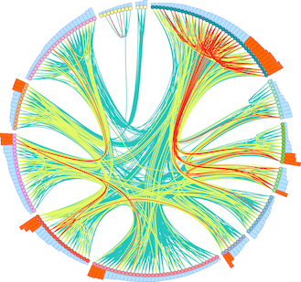





Thank you!
BACKGROUND
METHODS
RESULTS
CONCLUSIONS
With support from:
Dynamics and Neural Systems Lab
School of Physics
The University of Sydney
The University of Sydney Physics Foundation
Ben D. Fulcher
Supervisor
Oliver M. Cliff
Collaborator
Trent Henderson
Collaborator
The American Australian Association Graduate Education Fund

Slide 22
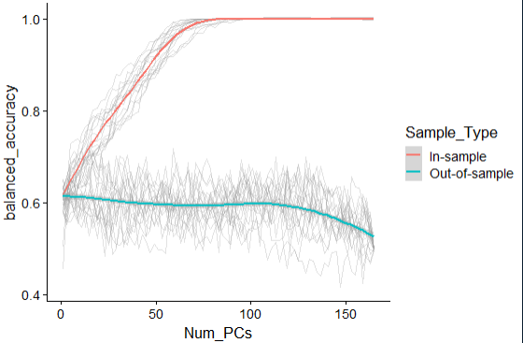
Addressing overfitting in high-dimensional space
~85 PCs sufficient to hit 100% in-sample balanced accuracy
Important question: these balanced accuracy values are still all lower than the final balanced accuracy values from the full results?
When the full set of PCs is used, there is a dropoff in out-of-sample balanced accuracy

Slide 23
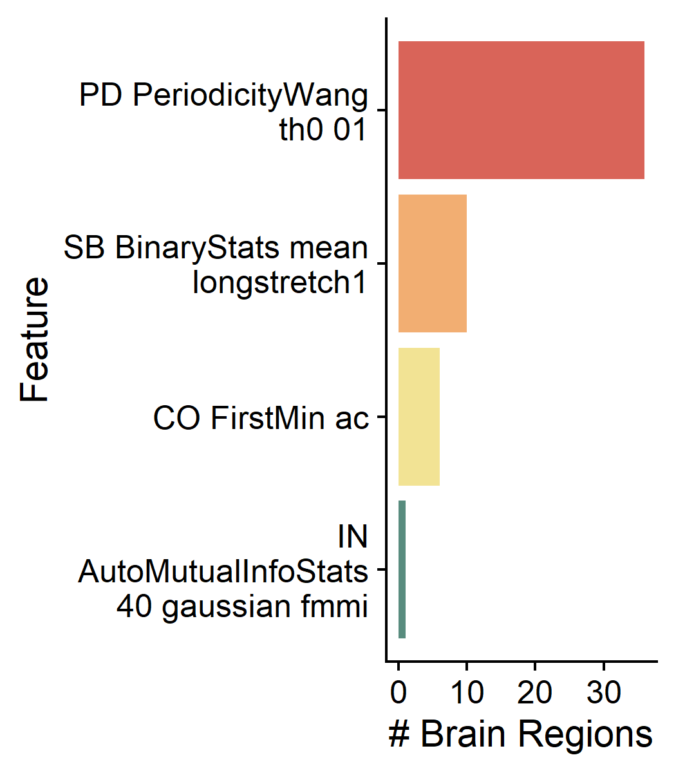
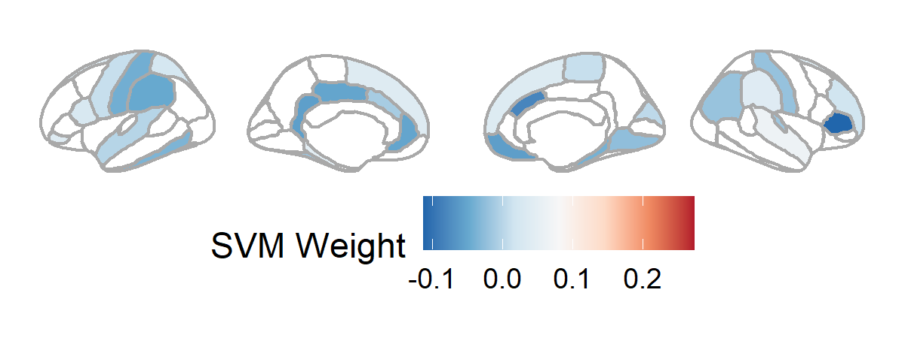
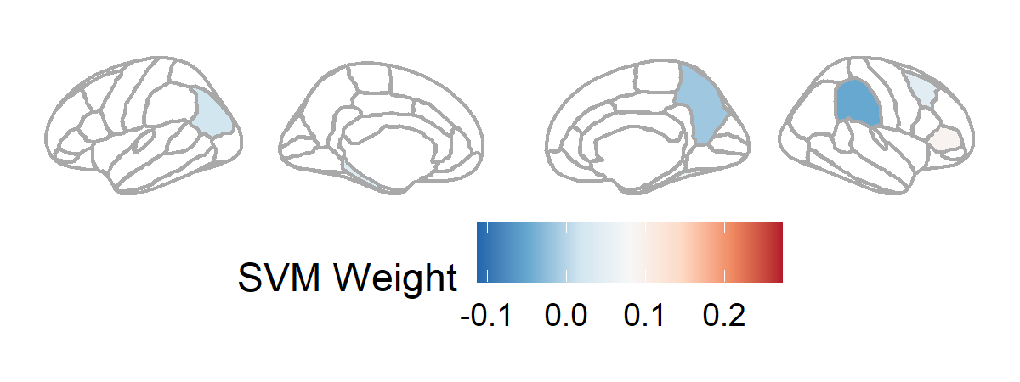
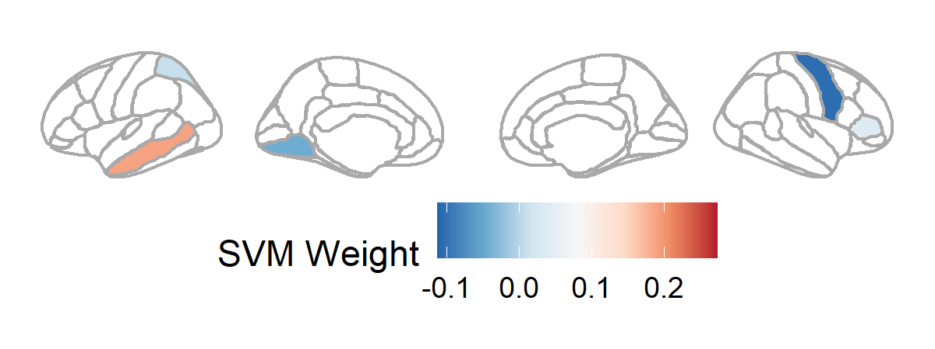
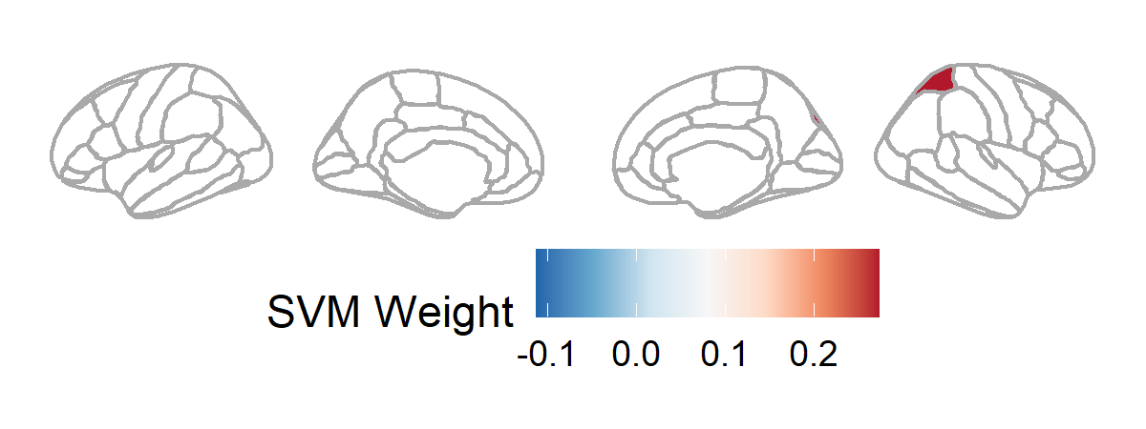
The combination of brain region X time-series dynamics
L1-regularized SVM for feature selection
Periodicity measure that is higher in slower-varying time-series
Longest sequence of consecutive time-points where value > the mean
First local minimum of the linear autocorrelation function
First local minimum of the nonlinear automutual information function
R superior temporal, R accumbens, L parahippocampal, R supramarginal, L pars orbitalis, L superior frontal, R superior frontal, L pars opercularis, L superior parietal, R rostral middle frontal, R pallidum, R temporal pole, R frontal pole, L precentral, R paracentral, R putamen, R cuneus
R pars triangularis, R fusiform, R caudal middle frontal, L parahippocampal, L temporal pole, L inferior parietal
L middle temporal, R pars triangularis, L superior parietal
R superior parietal
In-sample regularized SVM: 93.5% Bacc
Out-of-sample regularized SVM: 54.6%
R pars triangularis, R caudal anterior cingulate, R medial orbitofrontal, L isthmus cingulate, L rostral anterior cingulate, L posterior cingulate, L supramarginal, L postcentral, R parahippocampal, L inferior temporal, L frontal pole, L putamen, R lingual, R postcentral, R inferior parietal, L fusiform, R transverse temporal, L caudal anterior cingulate, L superior temporal
L frontal pole, R supramarginal, L hippocampus, R precuneus
R precentral, R pallidum, L lingual

